Slide 1

GCs architecture
Andrius Bertašius andrius.bertasius@mif.stud.vu.lt
Rytis Čepulis rytis.cepulis@mif.stud.vu.lt
Juozapas Gelčys juozapas.gelcys@mif.stud.vu.lt
Eligijus Mickus eligijus.mickus@mif.stud.vu.lt

Slide 2
Architecture styles and design patterns
Service oriented architecture
Client-Server
MVC
Data-Centered
Crud
Agent model

Slide 3
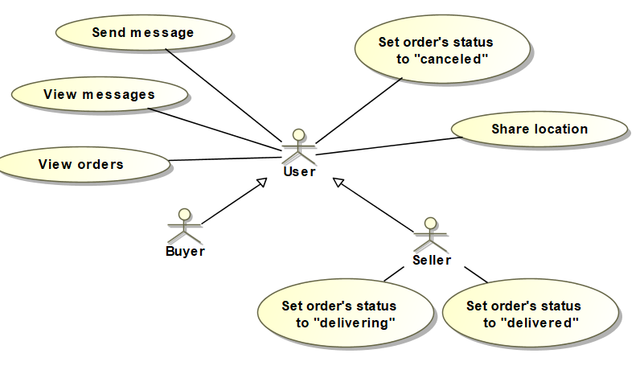
Context viewpoint
Figure 1. Use cases for modification.

Slide 4

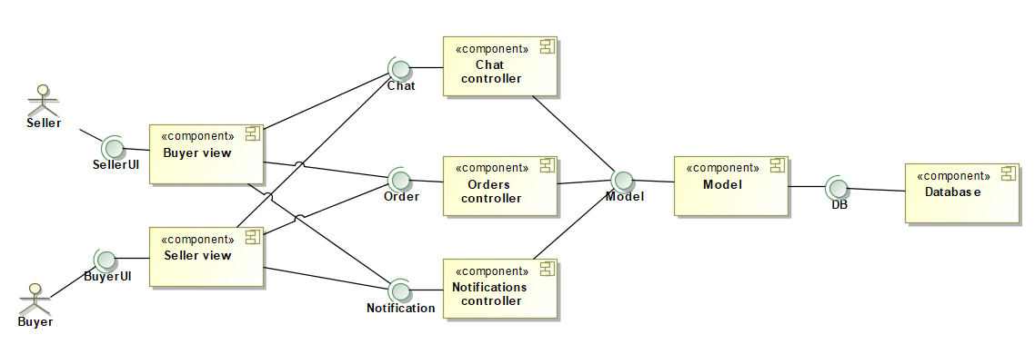
Functional viewpoint
Figure 2. MVC model
Figure 3. Components diagram for modification.

Slide 5
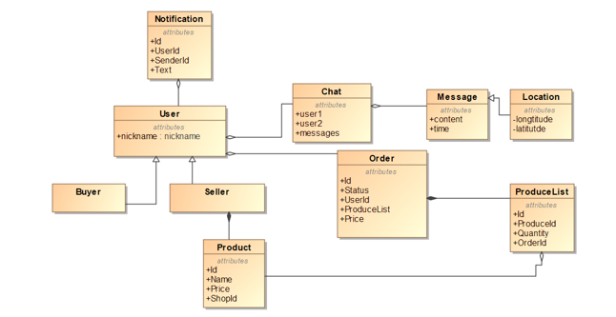
Information viewpoint
Figure 4. Static information model.

Slide 6
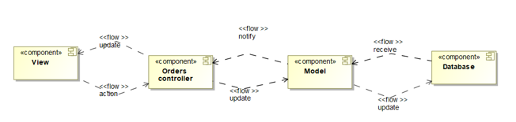
Figure 5. Information flow between components.

Slide 7
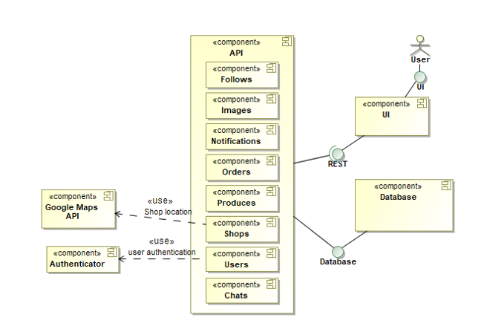
Development viewpoint
Figure 6. System components.

Slide 8
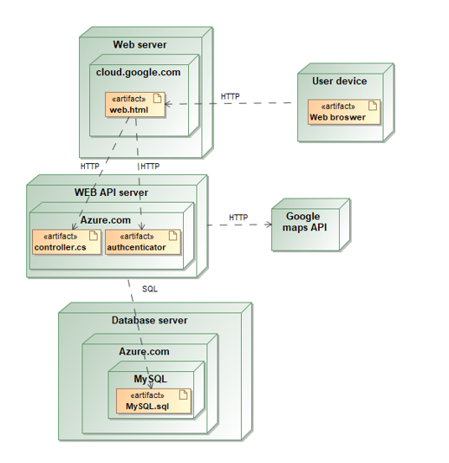
Deployment viewpoint
Figure 7. Dependencies.

Slide 9
Operational viewpoint
Support
Administration
Backup and restore
System updates

Slide 10
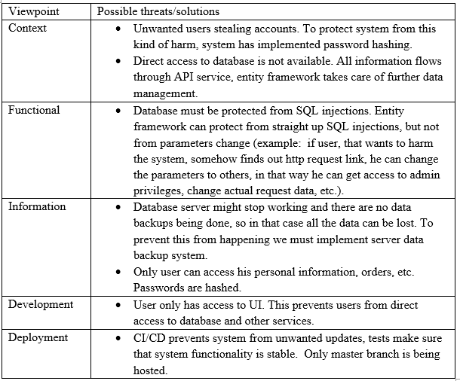
Security perspective
Table 1.

Slide 11
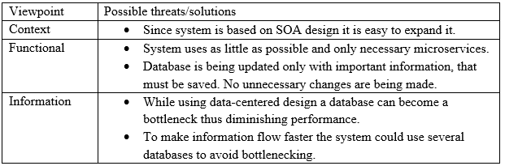
Performance and scalability perspective
Table 2.

Slide 12
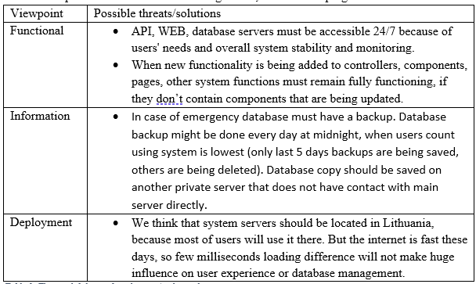
The availability and resilience
Table 3.

Slide 13
Thanks for attention

